Slide 1


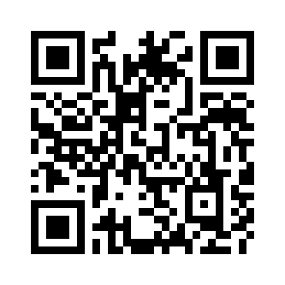

The Quest to Automate Fact-checking
Chengkai Li
University of Texas at Arlington
MetroCon, October 26, 2017
https://idir.uta.edu/claimbuster

Slide 2
Innovative Database and Information Systems Research Laboratory
idir.uta.edu
Chengkai Li, Associate Professor and Associate Chair
Research areas
Big Data Intelligence and Data Science (Database, Data Mining, Natural Language Processing)
Research directions
computational journalism, computational fact-checking
crowdsourcing and human computation
cybersecurity, social bots
data exploration by ranking/skyline/preference queries
graph database usability, knowledge graphs

Slide 3
Politicians Make False and Misleading Claims
Fact-checks on major party presidential nominees.
Source: PolitiFact.com
3

Slide 4
National Security Threats
Fake-news floods social media (“filter bubbles” and “echo chambers”).
Facebook trending topic algorithms promoted fake-news.
A sample of 140,000 Twitter users in the battleground state of Michigan shared as many junk news items as professional news during the final ten days of the 2016 election. http://politicalbots.org/?p=1064
Russian government interfered with the 2016 election. Fake-news websites and bots used.
Pizzagate: conspiracy theory led to shooting
4

Slide 5
Combating Falsehoods
100+ active fact-checking sites in 2017 (PolitiFact.com, FullFact.org, CNN, Washington Post, New York Times, …)
Google and Bing include fact-checks in search results.
Facebook lets users report false items and flags items disputed by fact-checkers.
5

Slide 6
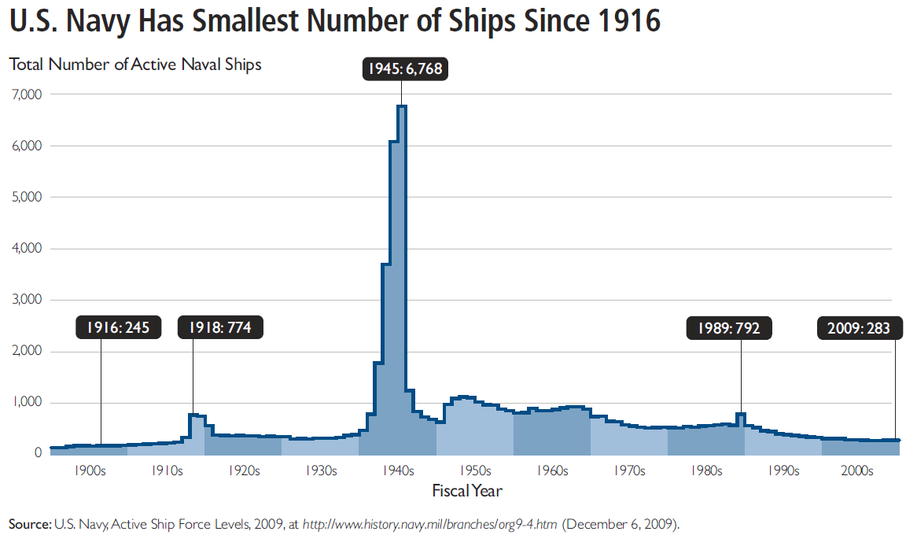
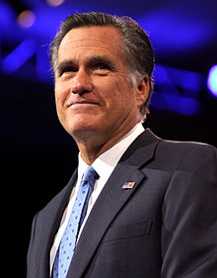
Fact-checking is Hard
“… our Navy is smaller than it's been since 1917", said Republican candidate Mitt Romney in third presidential debate in 2012.
http://en.wikipedia.org/wiki/Mitt_Romney
http://s3.amazonaws.com/thf_media/2010/pdf/Military_chartbook.pdf

Slide 7

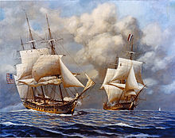
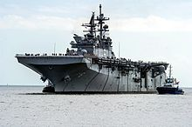
Fact-checking is Hard
“… our Navy is smaller than it's been since 1917", said Republican candidate Mitt Romney in third presidential debate in 2012.
vs
http://en.wikipedia.org/wiki/Mitt_Romney
http://s3.amazonaws.com/thf_media/2010/pdf/Military_chartbook.pdf
http://en.wikipedia.org/wiki/United_States_Navy

Slide 8
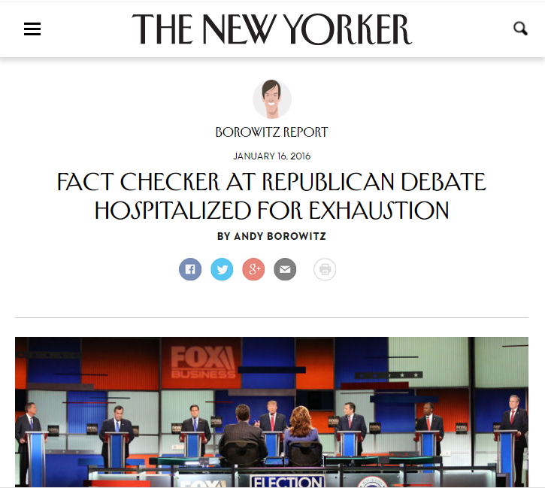
Demanding Task vs. Lack of Automated Tools
satire

Slide 9
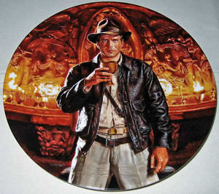
The Holy Grail: Automated, Live Fact-Checking
9

Slide 10
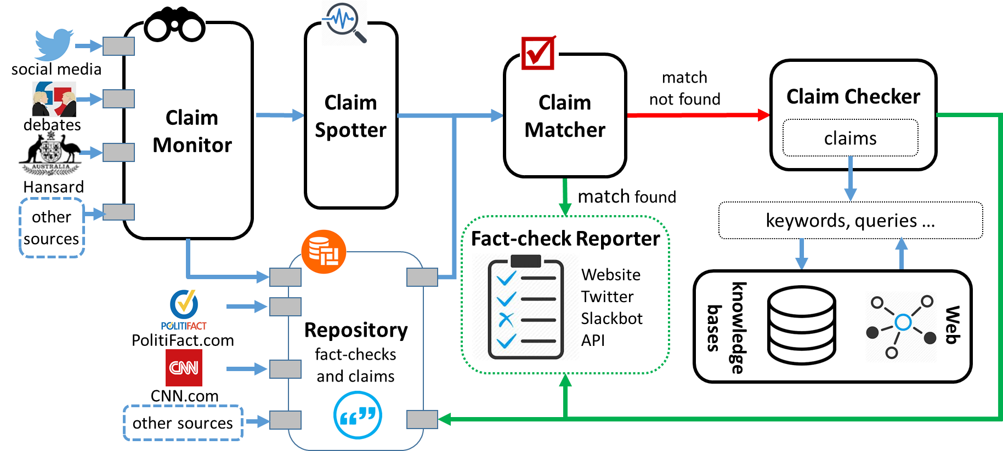
ClaimBuster: The First-ever End-to-end System
10

Slide 11
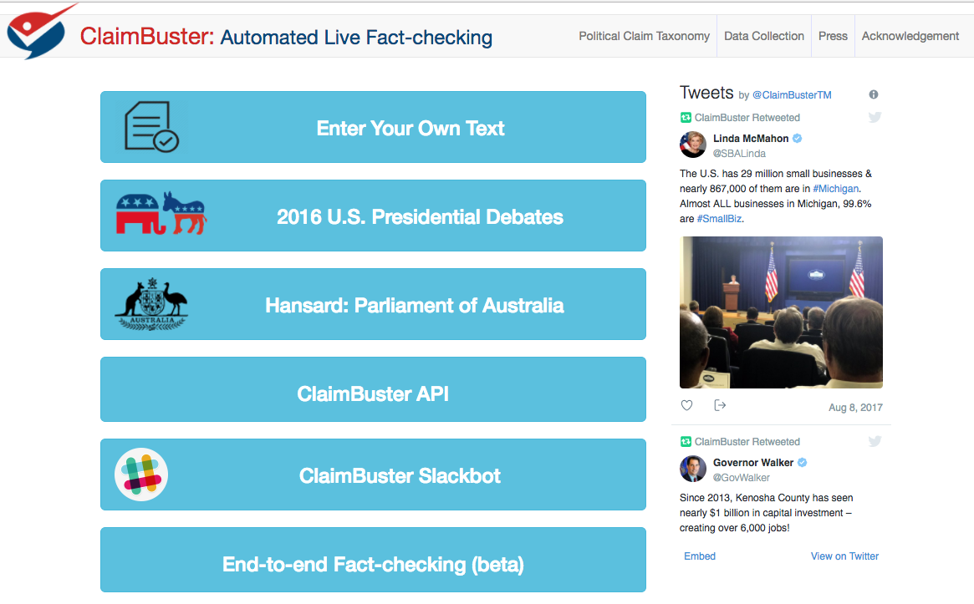

Slide 12
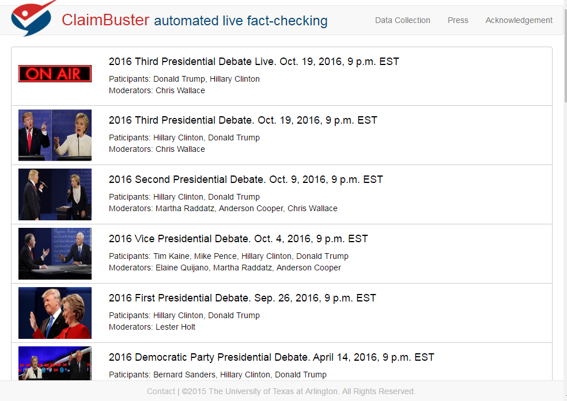
12

Slide 13
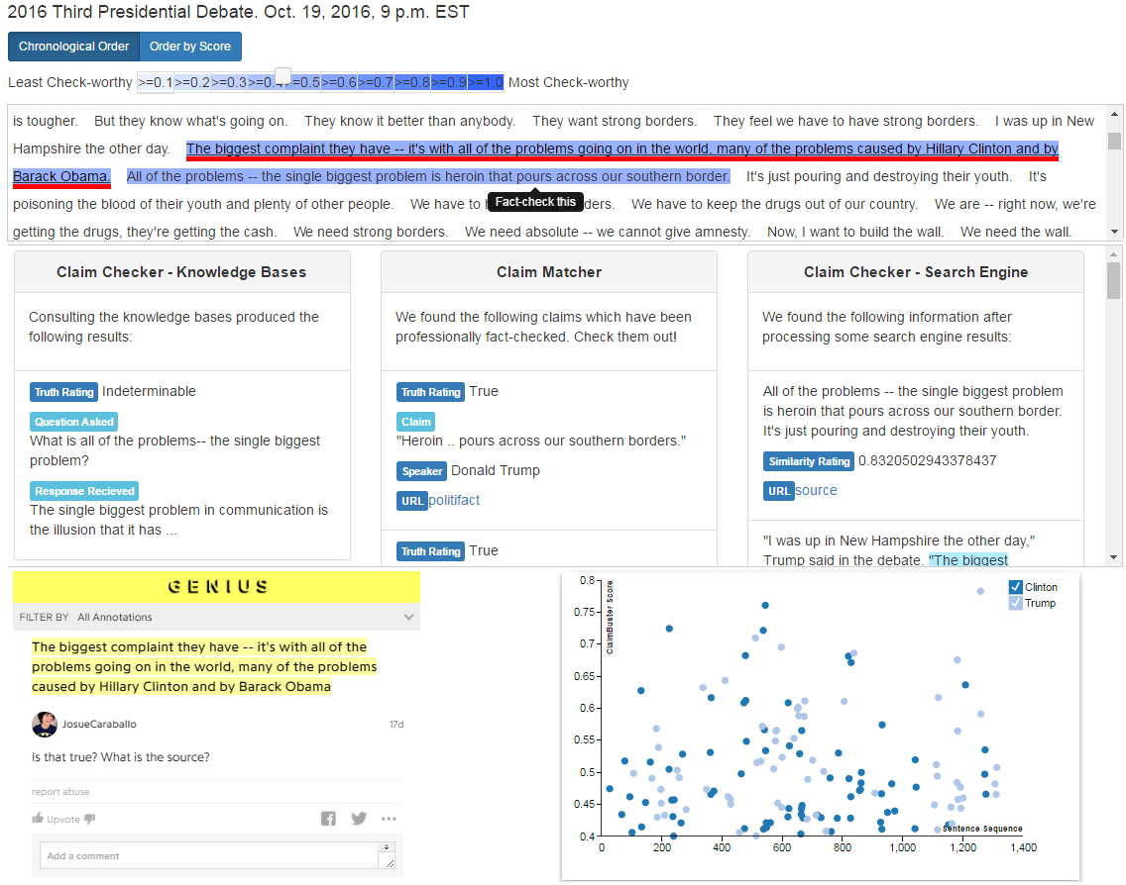
13

Slide 14
14

Slide 15
15

Slide 16
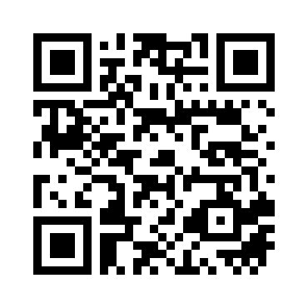
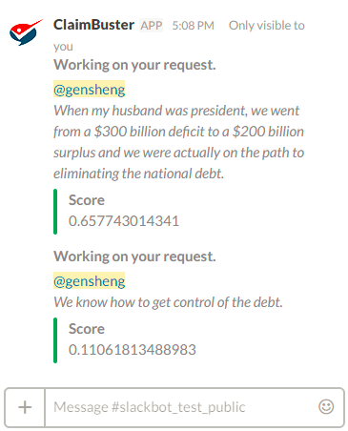
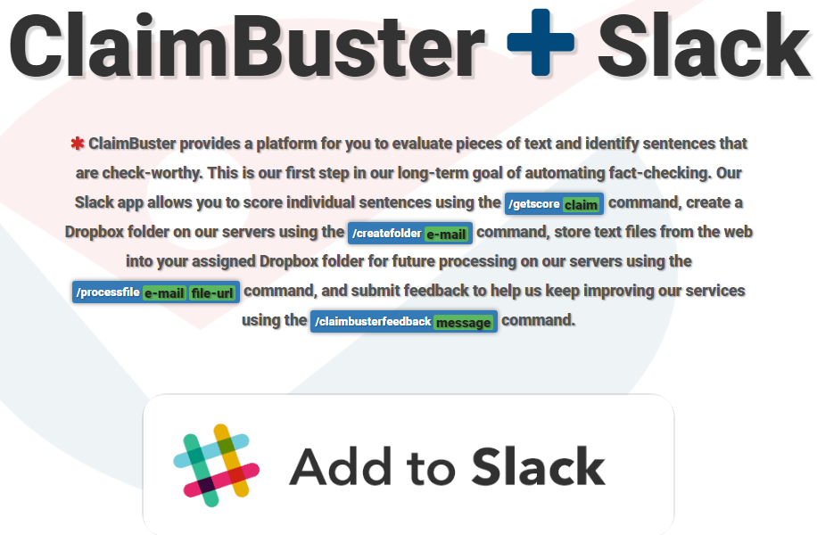
16

Slide 17
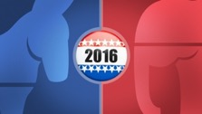




Finding Important Factual Claims:
A Supervised Learning Task
2016
Presidential
Debates
Human Annotation
Feature Extraction
Learning Algorithm
Ground Truth
Feature Vectors
Presidential Debate Transcripts (1960-2012)
Important factual claims
17

Slide 18
Dataset: Presidential Debate Transcripts
Source: http://www.debates.org/index.php?page=debate-transcripts
All 30 debates (11 general elections) in history: 1960, 1976—2012
20k sentences by presidential candidates: removed very short (< 5 words) sentences

Slide 19
Classification and Ranking by Check-worthiness
CFS: Important factual claims
“We spend less on the military today than at any time in our history.” “The President’s position on gay marriage has changed.” “More people are unemployed today than four years ago.”
UFS: Unimportant factual claims
“I was in Iowa yesterday.” “My mother enjoys cooking.” “I ran for President once before.”
NFS: No factual claims (opinions, questions & declarations)
“Iran must not get nuclear weapons.” “7% unemployment is too high.” “My opponent is wishy-washy.” “I will be tough on crime.” "Why should we do that?“ “Hello, New Hampshire!” “Our plan is to reduce tax rate by 10%.”

Slide 20
Feature Extraction
Word:
state, legislature, 87, percent, democrat
Sentiment: 0.032
I was in a state where my legislature was 87 percent Democrat.
Part-of-Speech:
Noun
Entity Type:
Quantity
Concept:
United States
Sentiment: [-1.0 to 1.0]
Word: tf-idf scores of 6130 words (excluding rare words)
POS Tag: 43 tags
Entity Type: 26 types

Slide 21
Feature Importance
6615 features in total
Used a Random Forest Classifier to calculate the importance of each feature.
Word | percent; people; jobs
POS Tag | noun; cardinal number; past tense; preposition
Entity Type | Quantity; Country; FieldTerminology; Person
Concept | United States Senate; Barack Obama
Sentiment

Slide 22
Classification Accuracy
Class Totals | Non-factual Statement (NFS) | 5894
 | Unimportant Factual Statement (UFS) | 485
 | Contains a Factual Statement (CFS) | 1849
Algorithm | Features | P NFS | P UFS | P CFS | P AVG* | R NFS | R UFS | R CFS | R AVG* | F NFS | F UFS | F CFS | F AVG*
SVM | Parts of Speech | 0.873 | 0.430 | 0.724 | 0.813 | 0.925 | 0.240 | 0.671 | 0.827 | 0.898 | 0.307 | 0.696 | 0.818
CNN | Google News¹ | 0.874 | 0.649 | 0.775 | 0.838 | 0.951 | 0.250 | 0.725 | 0.859 | 0.911 | 0.361 | 0.749 | 0.842
RNN | GLoVE² | 0.900 | 0.397 | 0.811 | 0.853 | 0.928 | 0.457 | 0.712 | 0.852 | 0.914 | 0.425 | 0.758 | 0.851
P: Precision | R: Recall | F: F1-Score
*: Average (AVG) is weighted based on the distribution of the number of labels in each class.
1: Pre-trained vectors trained on part of Google News dataset (about 100 billion words). The model contains 300-dimensional vectors for 3 million words and phrases. https://code.google.com/archive/p/word2vec/
2: Global Vectors for Word Representation using The Common Crawl corpus which contains petabytes of data collected over the last 7 years. https://nlp.stanford.edu/projects/glove/
22

Slide 23
Our Own CrowdFlower
23

Slide 24
Coder Quality
24

Slide 25
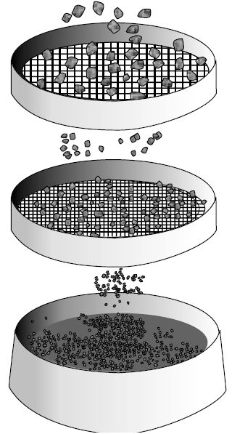
Ground Truth Collection
20788 sentences
374 coders
76552 labels
20788 sentences
20 months, 374 coders, ~$4,000 paid
30 training sentences
1032 screening sentences (731 NFS, 63 UFS, 238 CFS) to detect spammers & low-quality coders
86 top-quality coders
52333 labels
Class | Count | Percentage
CFS | 4849 | 23.52%
UFS | 2097 | 10.17%
NFS | 13671 | 66.31%
Majority voting
20617 admitted sentences
http://www.engineersdaily.com/2014/03/basics-of-soil-compaction.html
25

Slide 26
Examples of Challenging Cases
“But everybody's affected by the debt because of the tremendous interest that goes into paying on that debt everything's more expensive.”
“And General Brown has indicated uh – his apology, his regrets, and I think that will, uh - in this situation, settle the matter.”
26

Slide 27
Case Study: 2016 U.S. Presidential Election Debates
27

Slide 28
ClaimBuster: The First-ever End-to-end System
28

Slide 29
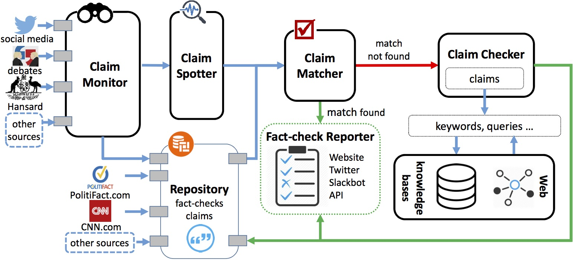


Ongoing Development
Front end: Claim portal
Repository of claims (social media, congressional record, news article)
Taxonomy
Structured Analysis
Search and browsing interface
Analytics
Back end: Claim understanding and algorithmic fact-checking
Claim representation and semantics
Claim-to-query translation
Question answering
Claim exceptionality/rebustness

Slide 30
Collaborators
Current/Former UTA Students
Fatma Arslan
Josue Caraballo
Naeemul Hassan
Damian Jimenez
Gensheng Zhang
Siddhantsanjeev Gawsane
Shohedul Hasan
Minumol Joseph
Aaditya Kulkarni
Anil Kumar Nayak
Vikas Sable
Collaborators
Bill Adair (Duke)
Pankaj Agarwal (Duke)
Peter Frays (University of Technology Sydney)
James Hamilton (Stanford)
Mark Tremayne (UTA)
You Wu (Google)
Jun Yang (Duke)
Cong Yu (Google)

Slide 31

Funding Sponsors
NSF IIS #1719054
Duke Tech & Check Cooperative
NSF I-Corps Teams #1565699
Knight Prototype Fund
NSF IIS Medium #1408928

Slide 32
In the Press

Slide 33
Botminator: Automated Detection of Fake-news Bots
Objective
discover social bots that publish and spread fake news
Recently funded by the Texas National Security Network
Interdisciplinary Approach
Social network, graph, and text mining
Code analysis
News content and effect analysis

